Slide 2
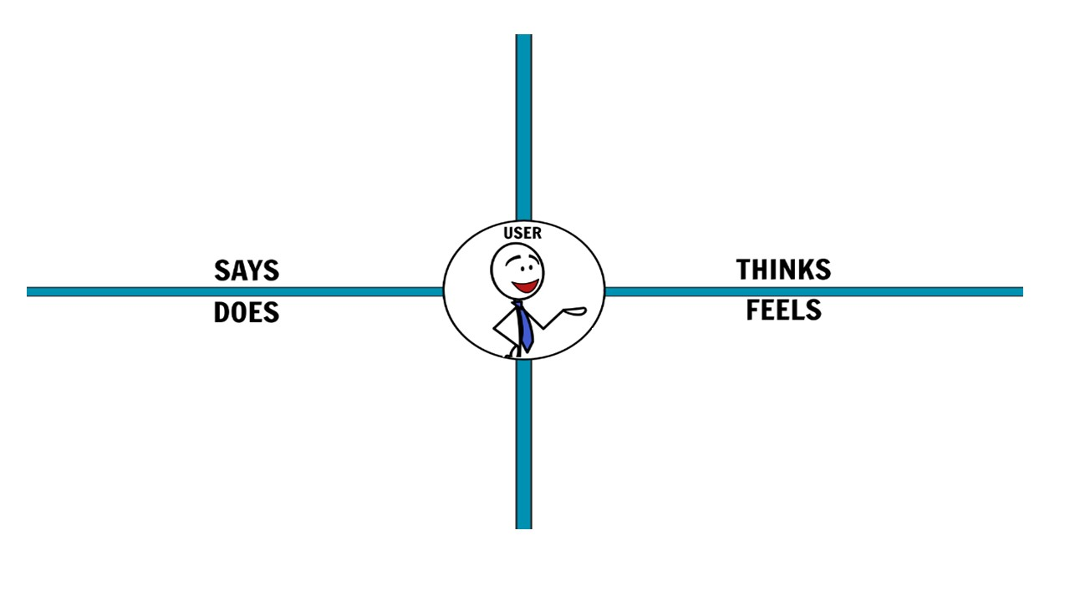
You can add or eliminate all the post-it you need

Slide 3
ANSWER THESE QUESTIONS…
How could you improve the sales of this product? List 5 selling strategies. | 1. 2. 3. 4. 5.
Write down two reasons why a client wouldn’t buy your product. How could you convince him/her that your product is better than the ones offered by the competitors? | 1. 2.
Decide the price of your product based on the price of your competitors. Why are you setting a higher/lower/equal price?

