Slide 2
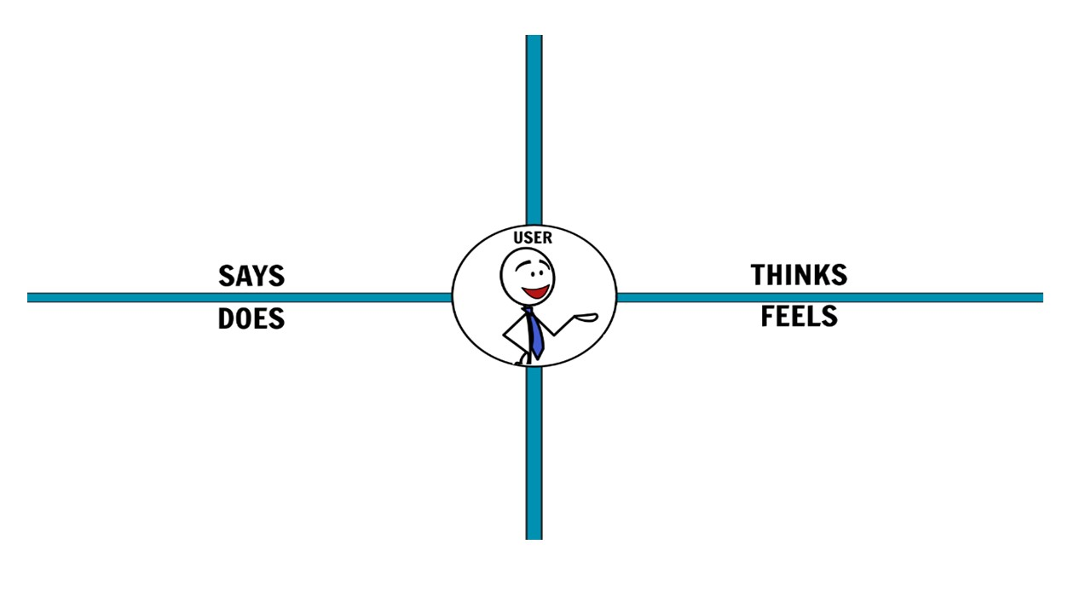
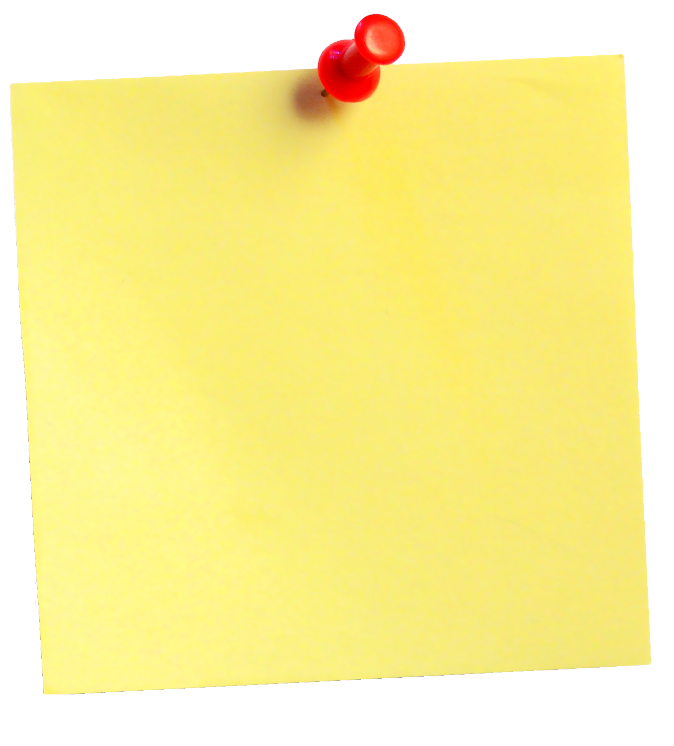
Notebook include a pen eraser or a dryer
waterproof and reusable
what do customers feel?
what do customers think?
lasts for a lifetime
can be cleaned with a cloth
comes with a special pen
it´s more expensive
It´s great becuase is better than other products
useful and renewable
Reduce the use of the paper
it can be cleaned with, wet cloths or a
dryer
they fells so good about avoid desforestation
waterproof
You can add or eliminate all the post-it you need

Slide 3
ANSWER THESE QUESTIONS…
How could you improve the sales of this product? List 5 selling strategies. (Johannes,Felix,Antonio) | 1. Influence people by saying that it´s climate neutral. 2. This notebook has a longer life duration 3. no one else is currently selling this 4. The notebook could be presented by a famous person because is reusable 5. Its waterproof and that is very rare
Write down two reasons why a client wouldn’t buy your product. How could you convince him/her that your product is better than the ones offered by the competitors? (Cristina and Celia) | 1. It is more expensive than a normal Notebook But you can use it for life 2. The notebook could be destroyed. But You can use this notebook for a lifetime. Also, one of the biggest problems with normal notebooks is that when it is raining, the papers can get wet. With this special notebook you do not have to be worried because it is waterproof. Moreover, is important to help the nature so the best option to take care for the environment is the best option. Finally, we have to say that if you buy our product you will not have to buy another next year.
Decide the price of your product based on the price of your competitors. Why are you setting a higher/lower/equal price? | 25 € for one notebook is a resonable price because it´s a product you can use for life and a pen is included and is it waterproof.

