Slide 1
Leadership Activity - Form C (presentation):
You will use the 2 slides of Form C to write your short presentation (be careful to include all issues requested as described in the guidelines- slide 5) ☺
You could divide the different topics among you and then combine the results. The presentation doesn’t have to be long, just clear and explanatory, based on strong and logical arguments!

Slide 2
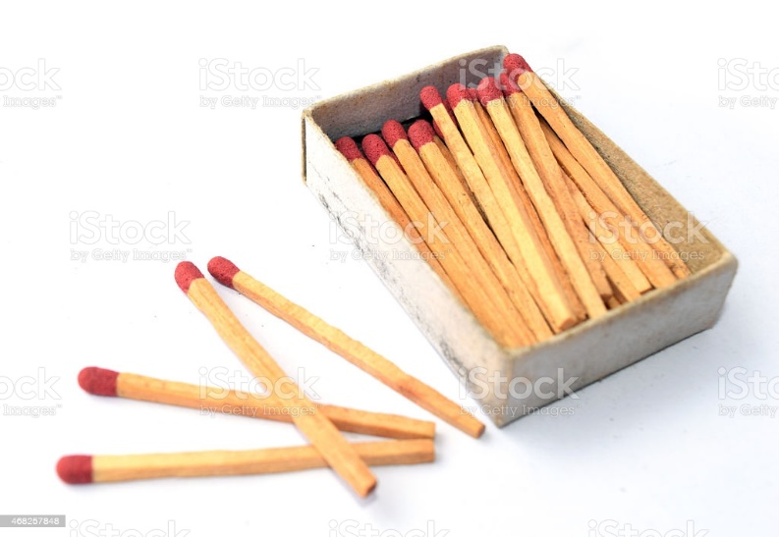
Form B:
BOX OF MATCHES
The utility of box of matches is diverse.
Firstly, you can light a fire to cook,for example, some food that you have in your bag or an animal you have hunted before. You can also get warmed thanks to that fire.
We could also use these matches to warm the snow slowly and drink it, avoiding burning our lips.

Slide 3
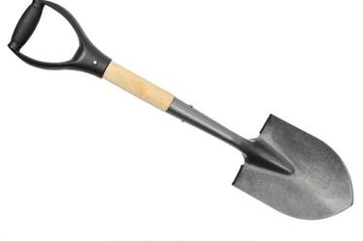
Form B:
SHOVEL
The shovel will help us to remove the snow so we can get out and prevent the avalanche from crushing us.
In addition, we can use the shovel to protect us when an animal such a wolves and bears want attack us and fight with him and when we get stuck we can open the way for us

Slide 4
Form B:
MEDICAL KIT
We decided to use it if anything happens as it contains the basic drugs and a thermal blanket
It is most important because it will help us do maintain in an optimal health.
It can be used as basic health and keep warm.

Slide 5
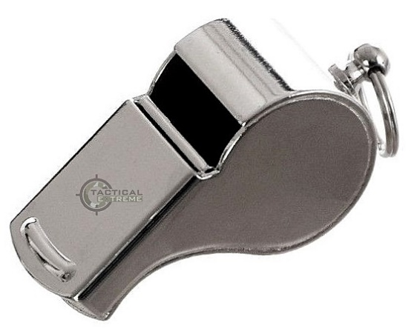
Form B:
WHISTLE
This object will produce noise to a certain distance. And we will use it in order to find the rest of our friends in case someone got lost, then use it to communicate between all of you for example if you divide into different group to look for resources such as food. By doing morse code, once we catch the attention of someone from the outside with the fire from the box of matches, therefore ask for help and get out.

