Slide 1
Survival case 1: Plane crash
Items

Slide 2
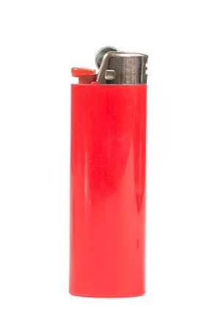
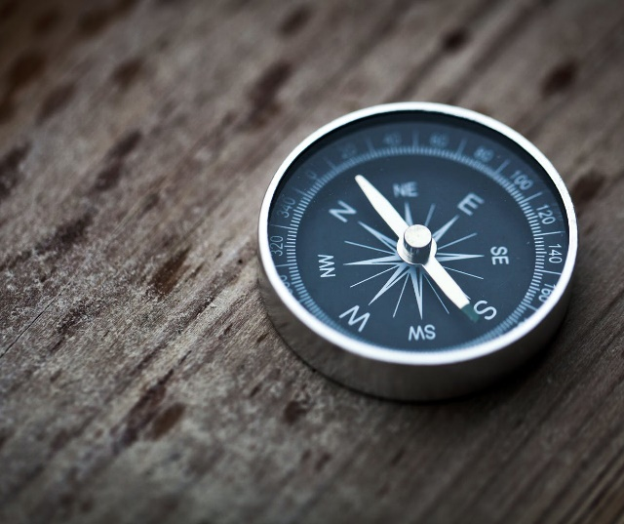
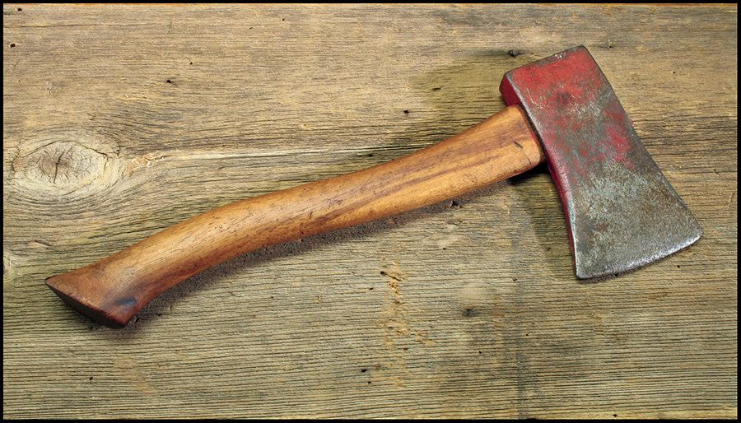
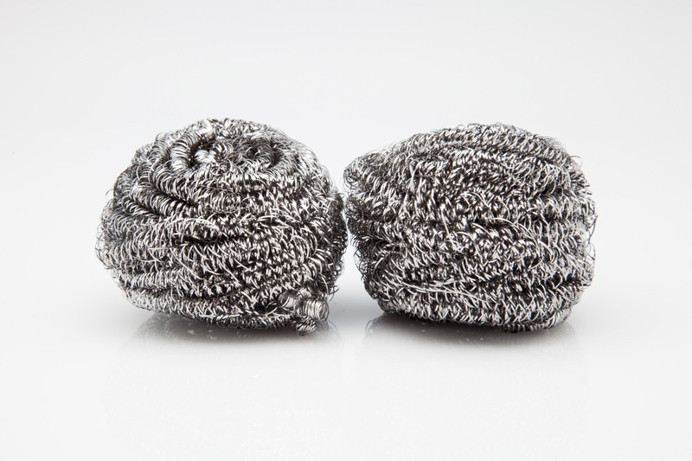
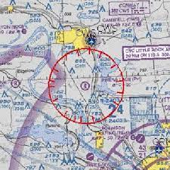
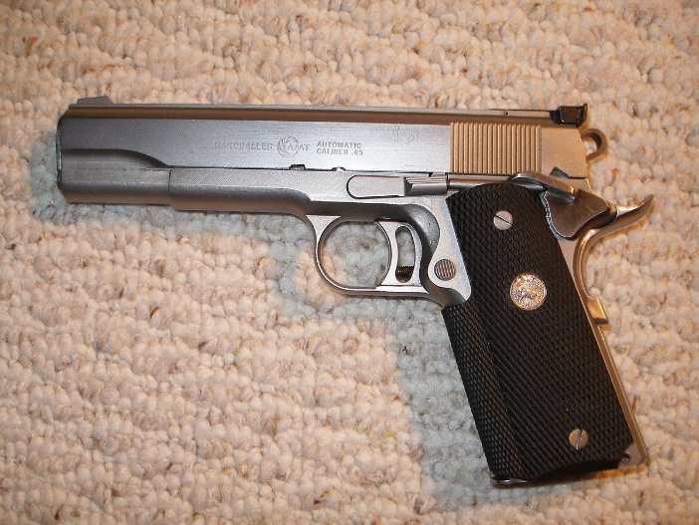
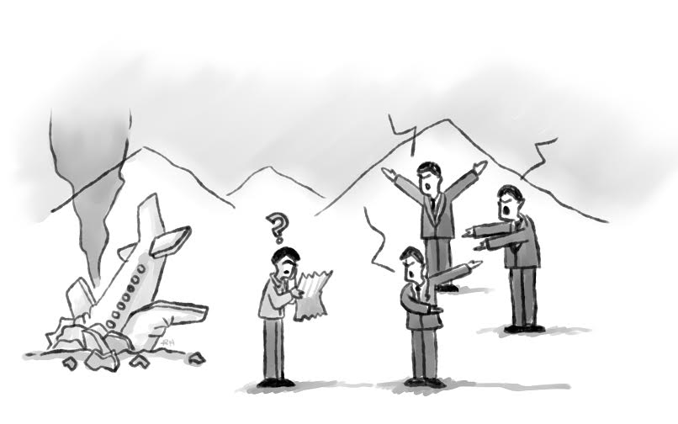
Compass
Ball of steel wool
Lighter
Small ax
Newspaper
Sectional plastic map
Piece of canvas
Loaded caliber pistol

Slide 3
Elections:
-Small ax: It would provide us protection against wild animals, and a way to obtain wood to make fire.(Jose Alberto)
-Compass: to properly use the map and to give us a sense of direction
-Lighter: to make a fire to keep us warm, given that we are in winter with light clothes.( Felix)
Moreover,
-Sectional plastic map: To provide us orientacion to go to the nearest town (About 30 km away). Also, it is key to knowing where we are, how much is left to our destination, what alternatives we have, the type of road surface, the slope to overcome, what are the geographical features that surround us, etc.

